Slide 1
The Three Types of Reseach and How to Construct Good Research Questions and Hypotheses
MKT3083
Market Research
Kilger

Slide 2
The Value of Data to Businesses

Slide 3

“AmEx developed sophisticated predictive models to analyze historical transactions and 115 variables to forecast potential churn. The company believes it can now identify 24% of Australian accounts that will close within the next four months.”
Mini-Case: American Express
- Gartner Analyst Doug Laney
Source: N. Laskowski, Ten big data case studies in a nutshell. http://searchcio.techtarget.com/opinion/Ten-big-data-case-studies-in-a-nutshell

Slide 4

“Wal-Mart Stores Inc.. The mega-retailer's latest search engine for Walmart.com includes semantic data. Wal-Mart says adding semantic search has improved online shoppers completing a purchase by 10% to 15%.”
Mini-Case: Walmart
- Gartner Analyst Doug Laney
Source: N. Laskowski, Ten big data case studies in a nutshell. http://searchcio.techtarget.com/opinion/Ten-big-data-case-studies-in-a-nutshell

Slide 5

“Infinity Property & Casualty Corp. built an algorithm out of that project and used the data to reap $12 million in subrogation recoveries.”
Mini-Case: Infinity
- Gartner Analyst Doug Laney
Source: N. Laskowski, Ten big data case studies in a nutshell. http://searchcio.techtarget.com/opinion/Ten-big-data-case-studies-in-a-nutshell

Slide 6

Monsanto “Its machine learning algorithm churns through more than 90 billion data points - the business benefits? In 2016, Monsanto saved $6 million and reduced its supply chain footprint by 4 percent.”
Mini-Case: Monsanto
Source: C. Boulton, 2017https://www.cio.com/article/3221621/analytics/6-data-analytics-success-stories-an-inside-look.html

Slide 7

Variables such as weather, geography, drivers and political climates cost its business. RRD was able to anticipate freight rates in real-time — seven days in advance at a 99 percent accuracy rate. The project paid for itself in under a year
Mini-Case: RRD
Source: C. Boulton, 2017https://www.cio.com/article/3221621/analytics/6-data-analytics-success-stories-an-inside-look.html

Slide 8

“Xerox found call center operator experience did not matter at all. Personality happened to be the key factor, as building strong teams with the spirits of partnership and mutual respect proved to be much more efficient, lowering their support personnel attrition rates by 20%, saving the company millions of dollars long-term.”
Mini-Case: Xerox
Source: https://itsvit.com/blog/8-real-life-business-success-stories-based-big-data-part-2/

Slide 9
Different Kinds of Research for Different Objectives

Slide 10



We need to think about just what kind of research or analytical strategy will get us to our desired destination. Is that strategy going to be:
Exploratory
Descriptive or Predictive
Causal

Slide 11
Exploratory
Exploratory research and analytics allows us to uncover new insights and discoveries that we hadn’t really realized before. This kind of activity is useful for things like:
What kind of new services or applications do our customers want?
Will people be able to easily figure out how to use the beta version of the new app we have built?
If we create a new type of flexible financial investment, will people understand how to make the best use of it?
How can we use new technologies like chat bots to enhance the relationship with our customers?
How can we use IoT to better connect with our customers?

Slide 12
Descriptive or Predictive
Descriptive research and analytics allows us to describe our business and its customers to make better sense of it. Understanding our customers and their needs through data helps us serve them better.
What does our best performing loan customer look like?
Not all of our customers are the same – what key characteristics make up the profile of our most risk averse investment client?
What kind of campaign – email or social media – gets the most revenue positive responses to our offers?
What are the most effective ways to bundle our credit card products with other financial services our customers have?
What are the best ways to reach our customers with our messages and what should those messages say?

Slide 13
Predictive research and analytics allows us to formally describe the relationships between key characteristics of our customers and their relationship to our business. It also allows us to make predictions about how our customers and prospects will react to changes and improvements in our products and services.
Descriptive or Predictive
What are the best predictors of loan default?
How should we configure our media advertising mix across television, Internet and mobile to most effectively reach our customers?
What is our next quarter forecast for new credit card sign ups?
What is our best prediction for annual profit yield for our new financial asset management service?

Slide 14
Causal research and analytics allows us to test to see if there is a causal relationship between two things. For example, you can test to see if people who saw your advertisement are more likely to purchase your product than if they didn’t see it.
Causal
Does automatically increasing the credit limit of a credit card increase the average balance on that card?
How should we configure our media advertising mix across television, Internet and mobile to most effectively reach our customers?
What is our next quarter forecast for new credit card sign ups?
What is our best prediction for annual profit yield for our new financial asset management service?

Slide 15
Causal research and analytics is a little trickier. That is, being able to claim that A causes B is a bit more involved than the other two types of analytics we have discussed. Here are the additional things that should be true in order to do causal analytics or research:
Causal
Does cause come before effect in time?
Are cause and effect associated or related to each other?
Can you eliminate other alternative possible causes or explanations?

Slide 16
Different Kinds of Research Exercise
EXERCISE #1

Slide 17
Constructing Good Research Questions and Hypotheses

Slide 18
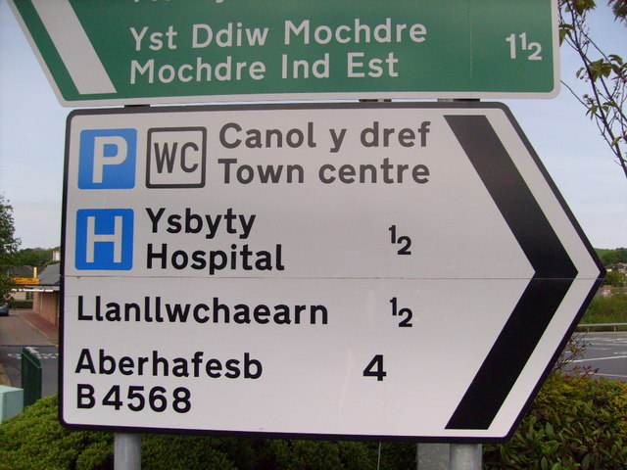
Before we can even understand and touch our data, we need to define a “destination”. That is, we need to decide what we want our data to explain and how we want to go about explaining it.

Slide 19
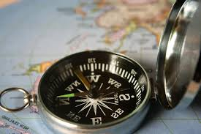
Good Research Questions
One of the first things we need to do is generate a good research question. Without that, we won’t have a good “compass” to guide us to our desired destination.

Slide 20
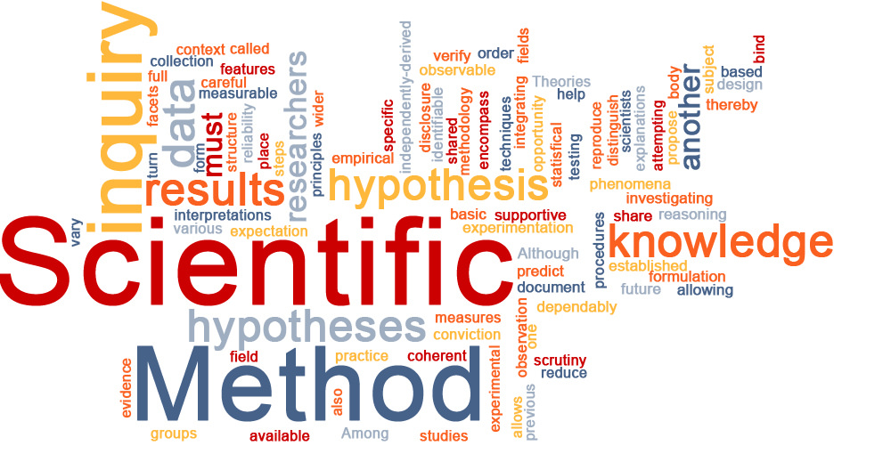
What makes a good research question?
Has the research question already been answered?
Is the research question well focused?
Are the constructs measurable?
Do you already have the data?
Is the answer to the question actionable?

Slide 21
Some Good Research Question Examples
Is there a relationship between educational level and propensity to purchase life insurance?
Are women more likely to respond to a social media ad than men?
Do men have a more positive attitude towards chatting with a chatbot than women?

Slide 22
Some Bad Research Question Examples
Bad research question examples
Do I need a big click through rate in order to meet my marketing objectives?
My loan initiation numbers are down this month – it must be due to the economy
I want to compare my new account acquisition rates with that of my competitors

Slide 23
Can You Write a Good Research Question?
EXERCISE #2

Slide 24
What makes a good hypothesis?
A good hypothesis is a statement
The statement is testable
Good hypotheses often contain 2 variables and a relation that compares them
Sometimes instead of a variable name, the values of the variable are used

Slide 25
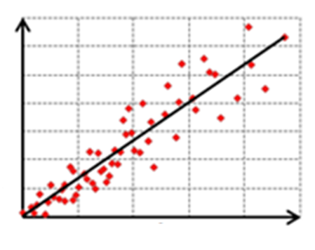
What makes a good hypothesis?
Understanding positive and negative relationships
A relationship between 2 variables in a hypothesis is often stated in terms of a negative or positive relationship
Positive relationship – one the value of one variable goes up, so does the other
“There is positive relationship between education and amount of life insurance held”

Slide 26
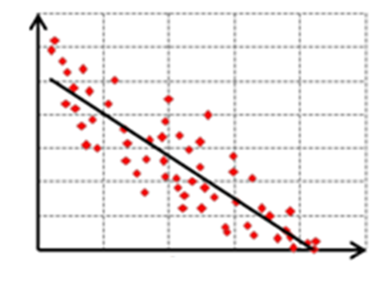
What makes a good hypothesis?
Negative relationship – one the value of one variable goes up, the other variable goes down
“There is negative relationship between age and level of social media use”

Slide 27
What makes a good hypothesis? Identifying the components
“There is positive relationship between education and amount of life insurance held”
| Relation |
| Variable 1 |
| Variable 2 |

Slide 28
What makes a good hypothesis? Identifying the components
“There is negative relationship between age and level of social media use”
| Relation |
| Variable 1 |
| Variable 2 |

Slide 29

What makes a good hypothesis? Identifying the components
Sometimes instead of a variable name, the values of the variable are used
“The average credit card balance for CHASE Sapphire is higher for male primary cardholders than female primary cardholders.

Slide 30

What makes a good hypothesis? Identifying the components
Sometimes instead of a variable name, the values of the variable are used
“Active duty members select higher average life insurance coverage than retired military members”

Slide 31
What makes a good hypothesis? Identifying the components
Variable 1: Gender
Variable 2: level of auto liability coverage
“The average CHASE credit card balance selected by women is higher than that of men”
| Variable 2 |
| Value Var 1 |
| Relation |
| Value Var 1 |

Slide 32
What makes a good hypothesis? Identifying the components
Variable 1: Duty Status
Variable 2: level of life insurance coverage
“Active duty members select higher average life insurance coverage than retired military members”
| Value Var 1 |
| Relation |
| Variable 2 |
| Value Var 1 |

Slide 33
Can you write a good hypothesis?
EXERCISE #3

